Slide 1
BM7703
Cross-cultural issues in international business
Week 6 -teams
Sara hooke

Slide 2
Working and leading in multicultural teams
This week we are going to…
Look at working and leading in multicultural teams with a specific focus on teamwork.

Slide 3
Why are we looking at this?
It links to your learning outcomes…
1.demonstrate a deep, systematic and integrated understanding in the specialised fields of intercultural issues and cross-cultural issues in an international management context.

Slide 4
Why are we looking at this?
It links to your assessment
You will need to advise your manager on the following:
1.What issues might the team experience whilst they work on this project? Think particularly about communication, decision making and trust
https://moodle.glos.ac.uk/mod/assign/view.php?id=1978799

Slide 5
Learning objectives for this session
To understand the how a team forms and operates
To understand how individuals affect team dynamics
To understand how our culture affects teamwork

Slide 6
Recap from last week
Influence and intrinsic/extrinsic motivation
Leader Definition and Styles
  Transformation v Transactional
The Role of a Leader
  Path Goal Leadership Approach
      Directive
      Supportive
      Participative
      Achievement Oriented
GLOBE – Culturally dependent Leadership Characteristics
Notes:
Globe: Compared how the different country clusters rate different forms of leadership, the GLOBE researchers considered six leadership profiles:
charismatic type (degree to which the leader can inspire and motivate others)
team oriented (degree to which the leader can foster a high functioning team),
participative type (degree to which leaders involve others in decision-making)
humane-oriented type (degree to which the leader shows compassion and generosity)
autonomous (degree to which the leader reflects independent and individualistic leadership)
self-protective (degree to which the leader is self-centered and uses a face-saving approach)

Slide 7
Agenda for today’s session
What is a Team
Stages of Teamwork- Tuckman
Team Dynamics- Belbin
The Effects of Culture -Meyer
How to make group tasks successful

Slide 8
What is a Team?
More than 2 people working together on a shared task or objective
“A team is a group of people who are interdependent with respect to information, resources, knowledge and skills and who seek to combine their efforts to achieve a common goal“ (Thompson, 2008)
Not ALL groups are Teams!
To be a team the group must be working towards a common goal, be reliant on each other in achieving that goal.
Notes:
What is a Team?
Is there a difference between a group and a team?
What?
*
A group is a collection of individuals who coordinate their efforts, while a team is a group of people who share a common goal. COMBINE THEIR EFFORTS FOR A COMMON GOAL
While similar, the two are different when it comes to decision-making and teamwork. In a work group, group members are independent from one another and have individual accountability.
Lift analogy- Group walks in (work on same floor, in same dept with same boss. When the lift breaks down, they become a team.

Slide 9
Why is being able to work as part of a team important?
Multinational teams of all shapes and sizes have been called the ‘heart’ of globalization (Snow, Snell, Canney Davision, & Hambrick, 1996)
They are routinely used to cope with our increasingly competitive, complex and culturally diverse 21st century world (DiStefano & Maznevski, 2000; Ravlin, Thomas, & Ilsev, 2000).

Slide 10
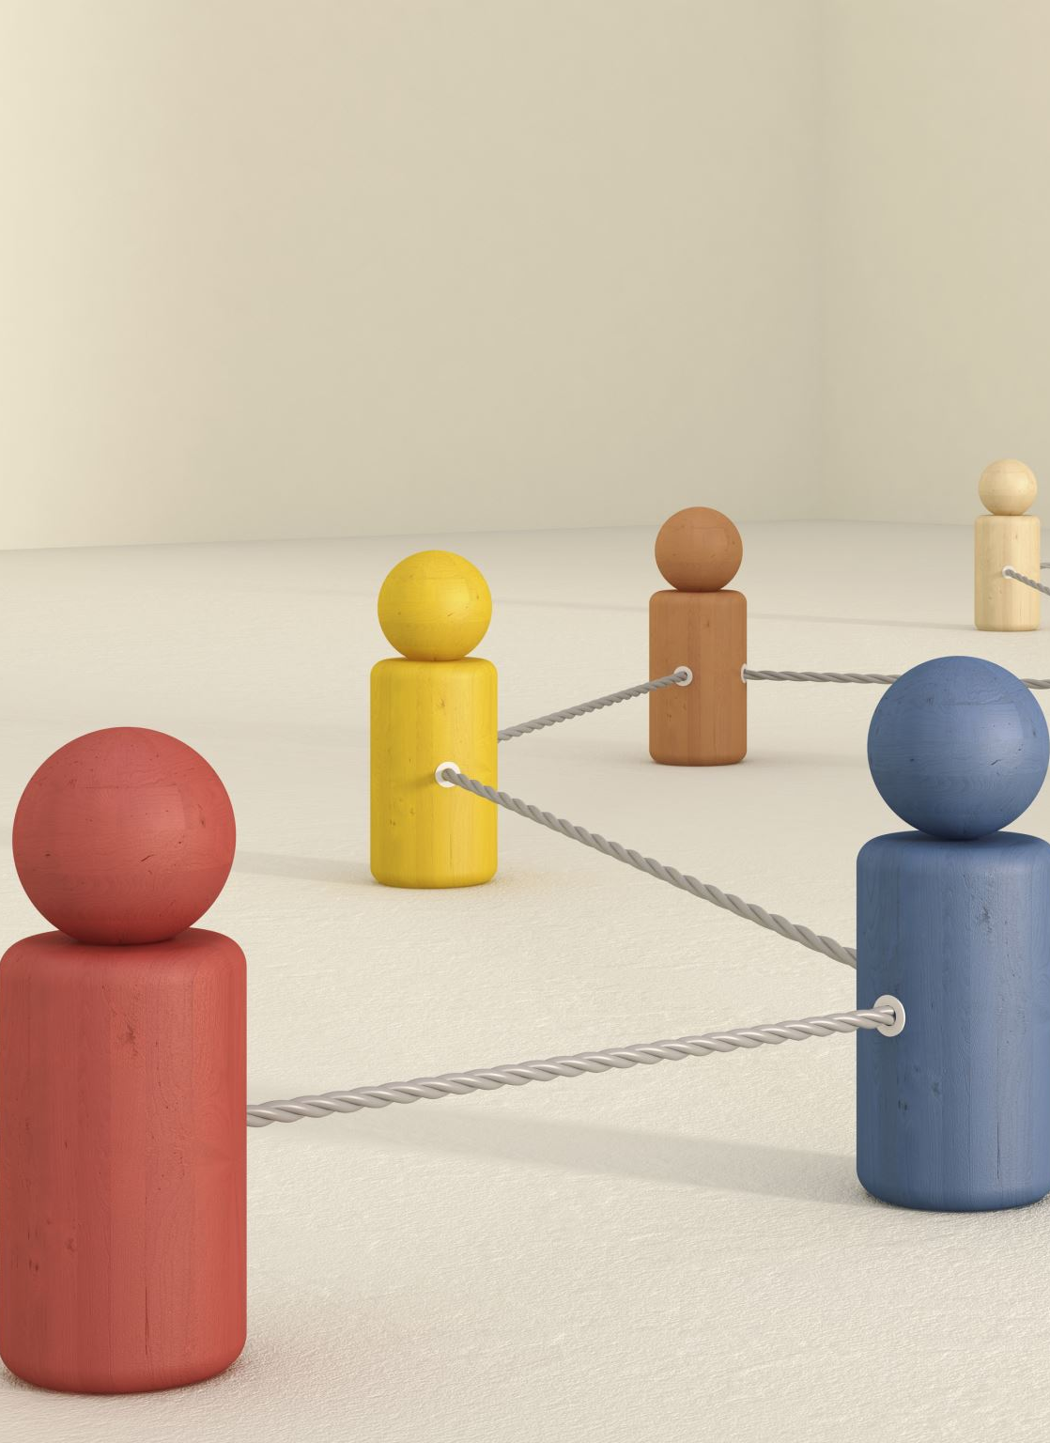
Stages of Teamwork
The model of group development was first proposed by Bruce Tuckman in 1965, who said that these phases are all necessary and inevitable in order for a team to grow, face up to challenges, tackle problems, find solutions, plan work, and deliver results.
Forming
Storming
Norming
Conforming
Adjourning (mourning)
Notes:
The team has to go through all the stages to grow, face up to challenges, tackle problems, find solutions, plan work, and deliver results.

Slide 11
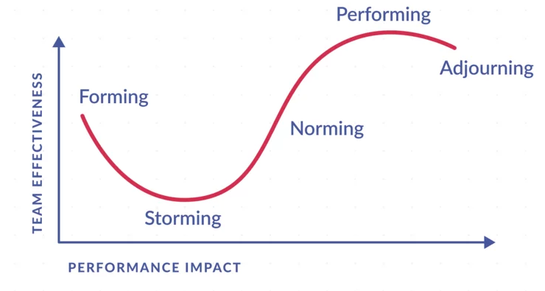
Notes:
Look at how effective the team is going through
Look the performance impact as the team moves through the stages.
Note that it is Tuckman’s model does allow for backwards and forwards between the stages, it can be reiterative and cyclical taking you in a loop through the storming, norming and performing stages. If this happens in your group work then don’t worry, its perfectly normal.

Slide 12
Forming
Introductions
Getting to know each other
Finding out about the task
Notes:
Forming
Characteristics of Forming include questioning, socializing, displaying eagerness, focusing on group identity and purpose, and sticking to safe topics. Strategies for this phase include taking the 'lead,' providing clear expectations and consistent instructions, and quick response times.
The team meets and learns about the opportunities and challenges, and then agrees on goals and begins to tackle the tasks. Team members tend to behave quite independently. They may be motivated but are usually relatively uninformed of the issues and objectives of the team. Team members are usually on their best behavior but very focused on themselves. Mature team members begin to model appropriate behavior even at this early phase. The meeting environment also plays an important role to model the initial behavior of each individual. The major task functions also concern orientation. Members attempt to become oriented to the tasks as well as to one another. Discussion centers on defining the scope of the task, how to approach it, and similar concerns. To grow from this stage to the next, each member must relinquish the comfort of non-threatening topics and risk the possibility of conflict.

Slide 13
Storming
Resistance
Lack of participation
Conflict
Moving towards group norms
Notes:
2. Storming
Traits of Storming include resistance, lack of participation, conflict, competition, high emotions, and moving towards group norms.
Strategies for this stage include normalizing matters and encouraging leadership.
This is the second stage of team development, where the group starts to sort itself out and gain each other’s trust. This stage often starts when they voice their opinions and, as a result of this, a conflict may arise between team members as power and status are assigned. When the group members start to work with each other they start to learn about individual working styles and what it is like to work with each other as a team, it also identifies different hierarchy of status of positions in the group. At this stage there is a positive and polite atmosphere and people are pleasant to each other and they have different feelings of excitement, eagerness and positiveness and others may have feelings of suspicion, fear and anxiety. The leader of the team will then describe the tasks to the group, describe the different behaviours to the group and how to deal and handle complaints. In this stage “…participants form opinions about the character and integrity of the other participants and feel compelled to voice these opinions if they find someone shirking responsibility or attempting to dominate. Disagreements and personality clashes must be resolved before the team can progress out of this stage, and so some teams may never emerge from “storming” or re-enter that phase if new challenges or disputes arise
At this point the performance of the team is not having much of an impact

Slide 14
Norming
Reconcillition
Engaged and supportive
Developing cohesion
Notes:
Features of Norming include reconciliation, relief, lowered anxiety, members are engaged and supportive, and developing cohesion. Strategies for this phase include recognizing individual and group efforts, providing learning opportunities and feedback, and monitoring the 'energy' of the group.
The now resolved disagreements and personality clashes result in greater intimacy, and a spirit of co-operation emerges. This happens when the team is aware they share a common goal. In this stage, all team members take the responsibility and have the ambition to work for the success of the team’s goals. They start tolerating the whims and fancies of the other team members. They accept others as they are and make an effort to move on. The danger here is that members may be so focused on preventing conflict that they are reluctant to share controversial ideas.
At this point the effectiveness and the performance of the team is improving.

Slide 15
Performing
Group norms and roles established
Motivated and knowledgeable
Focus on achieving goals
High levels of success
Notes:
Characteristics of Performing include demonstrations of interdependence, healthy system, ability to effectively produce as a team, and balance of task and process orientation. Strategies for this stage include celebrating, 'guide from the side' (minimal intervention), encouraging group decision-making and problem-solving, and providing opportunities to share learning across teams.
The group norms and roles are established, group members focus on achieving common goals, often reaching an unexpectedly high level of success. They are motivated and knowledgeable. The team members are now competent, autonomous and able to handle the decision-making process without supervision. Dissent is expected and allowed as long as it is channelled through means acceptable to the team.
Supervisors of the team during this phase are almost always participating. The team will make most of the necessary decisions. Even the most high-performing teams will revert to earlier stages in certain circumstances. Many long-standing teams go through these cycles many times as they react to changing circumstances. For example, a change in leadership may cause the team to revert to storming as the new people challenge the existing norms and dynamics of the team.

Slide 16
Adjourning (Mourning)
Task is completed
Team broken up
Notes:
In 1977, Tuckman, jointly with Mary Ann Jensen, added a fifth stage to the four stages: adjourning.
Traits of Adjourning include a shift to process orientation, sadness, and recognition of team and individual efforts. Strategies for this phase include recognizing change, providing an opportunity for summative team evaluations, and providing an opportunity for acknowledgments.
Having an awareness of all of these stages will help you to cope with group/teamwork in the future. For example just because things have got a bit rocky during in the storming stage, don’t give up. This is completely normal. Don’t forget is Tuckman’s model does allow for backwards and forwards between the stages, it can be reiterative and cyclical taking you in a loop through the storming, norming and performing stages. If this happens in your group work then don’t worry, its perfectly normal.

Slide 17
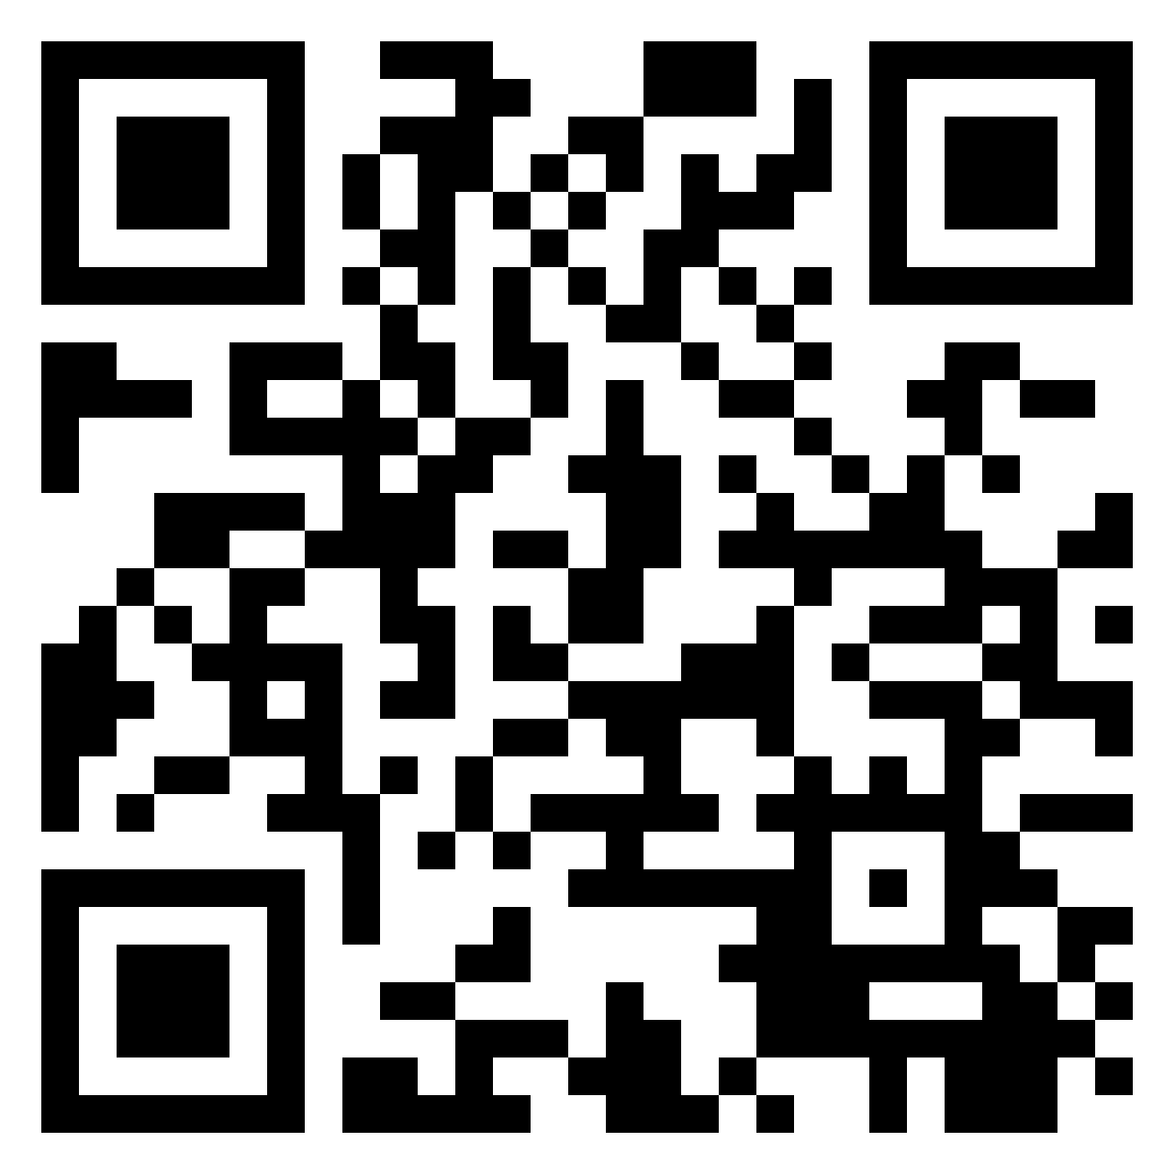
How does culture affect the different stages of teamwork (Tuckman’s model)?
Pin
https://uniofglos.padlet.org/shooke/sem-1-24-25-how-does-culture-affect-the-different-stages-of--s4s9tnfo99r9l4tb
Notes:
Forming
Storming
Norming
Performing
Adjourning

Slide 18
Virtual Teams:
Technology and the workplace of the future
(Townsend et al, 1998)
“This new workplace will be unrestrained by geography, time and organizational boundaries; it will be a virtual workplace, where productivity, flexibility and collaboration will reach unprecedented new levels.”

Slide 19
What are Virtual teams?
Members geographically and functionally dispersed.
High technological requirements.
Changing nature of assignments and team membership.

Slide 20
Why virtual teams?
Flatter organisational structures.
A need for inter-organisational co-operation.
Changes in worker expectations.
Globalisation of corporate activity.
Notes:
More people need to be working together (less hierarchy)-as a team

Slide 21
Challenges in creating virtual teams
Managerial control.
Definition of role and function;
Technical systems;
Staff development;
Technophobia and other forms of resistance;
Trust and Cohesion.

Slide 22
Virtual teams
The virtual context has enabled teams to complete tasks more efficiently and quickly than ever before,and access the best resources and people in locations around the globe.(Zander et al. 2012)
In GVTs (Global Virtual Teams)
‘‘distance amplifies dysfunction’’ (Davis & Bryant, 2003, p. 310)
Notes:
Although there are many positives there are also challenges
Given the virtual context that global virtual teams (GVTs) work in, members’ different cultural backgrounds, the interface of technology, and the fact that members are often not in synch because of different time zones, the role of leading virtual teams is riddled with complexity. Because GVT members often cannot see their leader, one might get the sense that virtual team leaders need to have special knowledge or qualities or display certain types of behaviors to be effective.

Slide 23
Important competencies for leaders in GVT’s
direction and goal setting,
communication,
facilitating teamwork
motivating and inspiring
-Joshi and Lazarova (2005)
Notes:
Joshi and Lazarova (2005) sought answers to the question of what competencies are identified as important for leaders in multinational virtual teams.
direction and goal setting, communication, facilitating teamwork and motivating and inspiring. However, team leaders and team members differed in their views about other competencies. For example, managing cultural diversity was mentioned as important by 65% of team leaders, but only 5% of members. Empowering was mentioned only by team leaders, and mentoring and coaching and resource acquisition – only by team members.

Slide 24
The Effects of Cultural Diversity in Virtual Teams Versus Face-to-Face Teams
heterogeneous teams were less satisfied and cohesive and had more conflict than the homogeneous teams
the performance of the virtual heterogeneous teams was superior to that of the F2F heterogeneous teams.
The use of technology can reduce the negative impacts of culture in the early life of a team.
Staples, D. S., & Zhao, L. (2006). The Effects of Cultural Diversity in Virtual Teams Versus Face-to-Face Teams. Group Decision and Negotiation, 15(4), 389–406. https://doi.org/10.1007/s10726-006-9042-x

Slide 25
Questions…
What are the positives of having a diverse team?
What are the negative aspects diverse teams?
  What do these problems lead to?
Notes:
There can be both positive and negative aspects of team diversity. Value in diversity comes
from increased creativity, innovation and flexibility (Jehn, Northcraft and Neale 1999; Lau
and Murninghan 1998; McLeod et al. 1996). A variety of perspectives and experiences
(i.e., deep-level diversity) can bring more information and ideas into the team, stimulate
thinking, and can bring different networks of contacts and resources to the team. When the
deep-level diversity is relevant to the task facing the team, higher-quality outcomes should
result; however, if the variety is not relevant to the task, then there is no basis for expecting
the diversity to enhance the team’s activity. Therefore, the beneficial effect of deep-level
diversity within a team is contingent on the relevance of the diversity to the team’s task
(McLeod et al. 1996).
Negative aspects of team diversity include communication difficulties, misunderstandings,
decreased cohesion and increased conflict.
These process losses result in decreased performance and satisfaction (Hambrick et al. 1998; Lau and Murninghan 1998; Williams
and O’Reilly 1998).
Social identity theory, social categorization theory and the similarity/
attraction paradigm suggests that the negative effects associated with diversity are
due to the creation of in-groups and out-groups (Carte and Chidambaram 2004; Salk and
Brannen 2000). People implicitly categorize themselves into subgroups according to salient
cues and identify more closely with people they perceive as being similar to themselves.
They do this to achieve and maintain positive self-identity.
Overt characteristics (readily observable traits) is typically referred to as surface-level diversity (race, ethnicity, gender, and age), while variety in unobservable characteristics (skills, information and knowledge, values, cognitive
processes, and experience) is referred to as deep-level diversity (Carte and Chidambaram 2004).

Slide 26
Do you agree…?
High intellect teams are more likely to succeed than those with lower intellect.

Slide 27
Team Dynamics
In 1969, Dr Meredith Belbin conducted research into Team Dynamics at the Henley Business School. Belbin postulated that high-intellect teams would succeed where lower intellect teams would not.
However, the outcome of this research was that certain teams, predicted to be excellent based on intellect, failed to fulfil their potential.
In fact, it became apparent by looking at the various combinations that it was not intellect, but balance, which enabled a team to succeed.
Successful teams were characterised by the compatibility of the roles that their members played while unsuccessful teams were subject to role conflict.
Notes:
It’s the dynamics of the team not necessarily the intellectual capabilities of the group, that enable success.

Slide 28
Team Dynamics
Belbin observed from the research that individuals reacted very differently within the same broad situation.
Individual differences can cause a group to fall apart. People just don’t fit in.
On the other hand, variation in personal characteristics can become a source of strength if they are recognised and taken account of.
Notes:
Belbin observed from the research that individuals reacted very differently within the same broad situation.
Individual differences can cause a group to fall apart. People just don’t fit in.
On the other hand, variation in personal characteristics can become a source of strength if they are recognised and taken account of.
So understanding the nature of these differences can become an essential first step in the management of people, providing one can recognise what is useful for a given situation and what is not.
High Performing Teams need appropriate:
Skills
Attitudes of Members

Slide 29
Team Dynamics
Belbin discovered that in order for teams to become high performing they need a mix of behaviours.
Belbin Identified nine behaviours that are required for high performing teams.
Teams do not need all behaviours all of the time.
Team members often have 2 or more behaviours, therefore teams do not need nine members.
Notes:
Belbin discovered that in order for teams to become high performing they need a mix of behaviours.
Belbin Identified nine behaviours that are required for high performing teams.
Teams do not need all behaviours all of the time.
Team members often have 2 or more behaviours, therefore teams do not need nine members.
By understanding your own team behaviours and those of the rest of the team you are better able to communicate and work together.

Slide 30
Belbin Questionnaire- 30 mins

Slide 31
Team Dynamics
Nine Team roles:
          Resource Investigator (RI)
          Teamworker (TW)
          Coordinator (CO)
          Plant (PL)
          Monitor Evaluator (ME)
          Specialist (SP) – Added after initial work.
          Shaper (SH)
          Implementor (IM)
          Completer Finisher (CF)

Slide 32
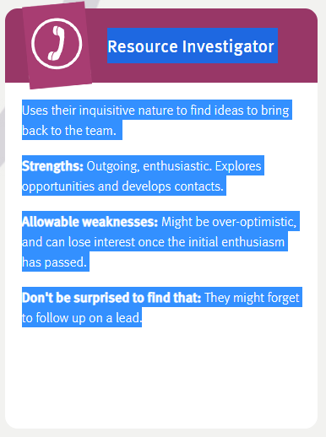
Team Dynamics
Notes:
People / feelings
Resource/investigator
Explores new ideas and possibilities with energy and with others. Good networker. Can be too optimistic and lose energy after the initial flush.
People oriented role

Slide 33
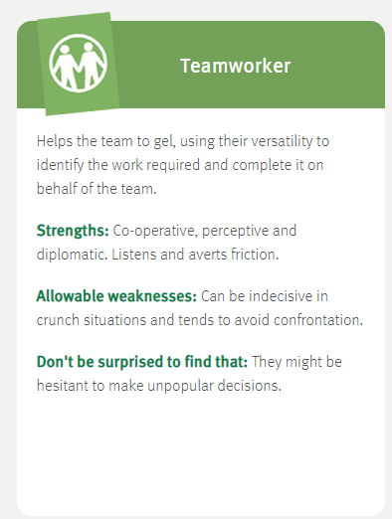
Team Dynamics
Notes:
People / feelings
Team worker
Cares for individuals and the team. Good listener and works to resolve social problems. Can have problems making difficult decisions.
People oriented role

Slide 34
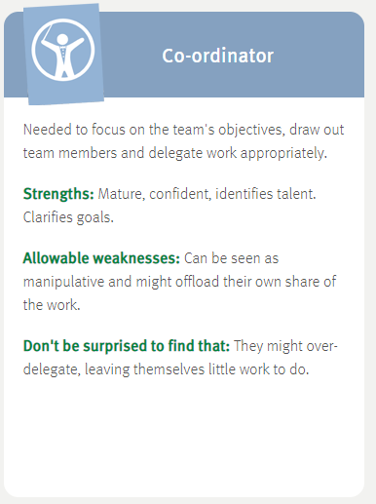
Team Dynamics
Notes:
People / feelings
Coordinator
Respected leader who helps everyone focus on their task. Can be seen as excessively controlling.
Traditional team leader role
People oriented role

Slide 35
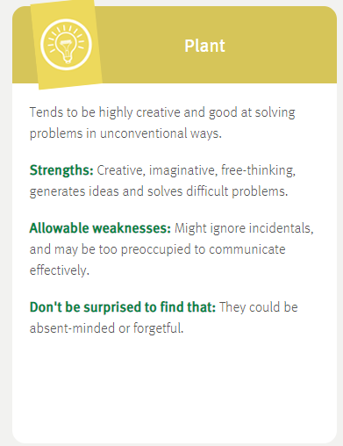
Team Dynamics
Notes:
Thinking / problem-solving
Plant
Solves difficult problems with original and creative ideas. Can be poor communicator and may ignore the details.
Cerebral role

Slide 36
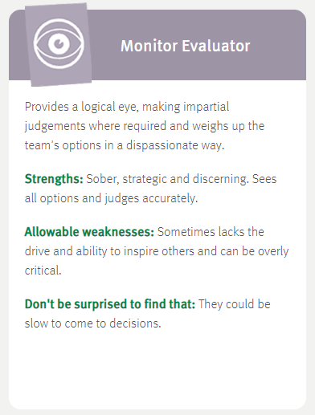
Team Dynamics
Notes:
Thinking / problem-solving
Monitor/Evaluator
Sees the big picture. Thinks carefully and accurately about things. May lack energy or ability to inspire others.
Cerebral role

Slide 37
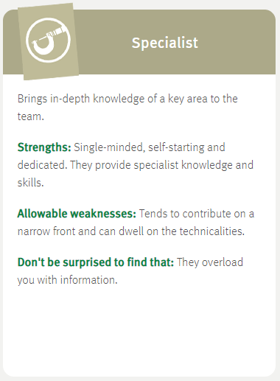
Team Dynamics
Notes:
Thinking / problem-solving
Specialist
Has expert knowledge/skills in key areas and will solve many problems here. Can be disinterested in all other areas.
Cerebral role

Slide 38
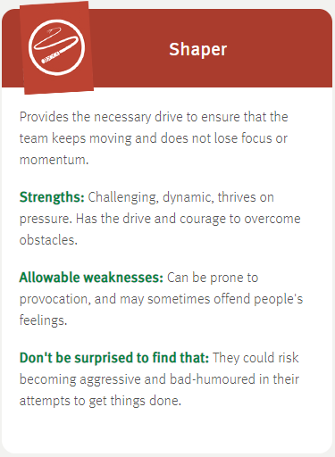
Team Dynamics
Notes:
Doing / acting
Shaper
Lots of energy and action, challenging others to move forwards. Can be insensitive.
Action oriented role

Slide 39
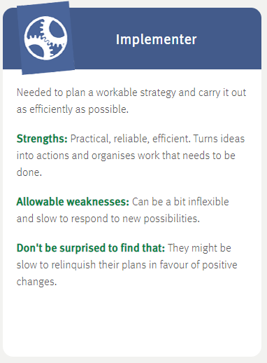
Team Dynamics
Notes:
Doing / acting
Implementer
Well-organised and predictable. Takes basic ideas and makes them work in practice. Can be slow.
Action oriented role

Slide 40
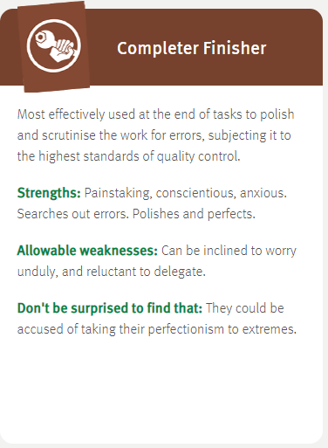
Team Dynamics
Notes:
Doing / acting
Completer/Finisher
Reliably sees things through to the end, ironing out the wrinkles and ensuring everything works well. Can worry too much and not trust others.
Action oriented role

Slide 41
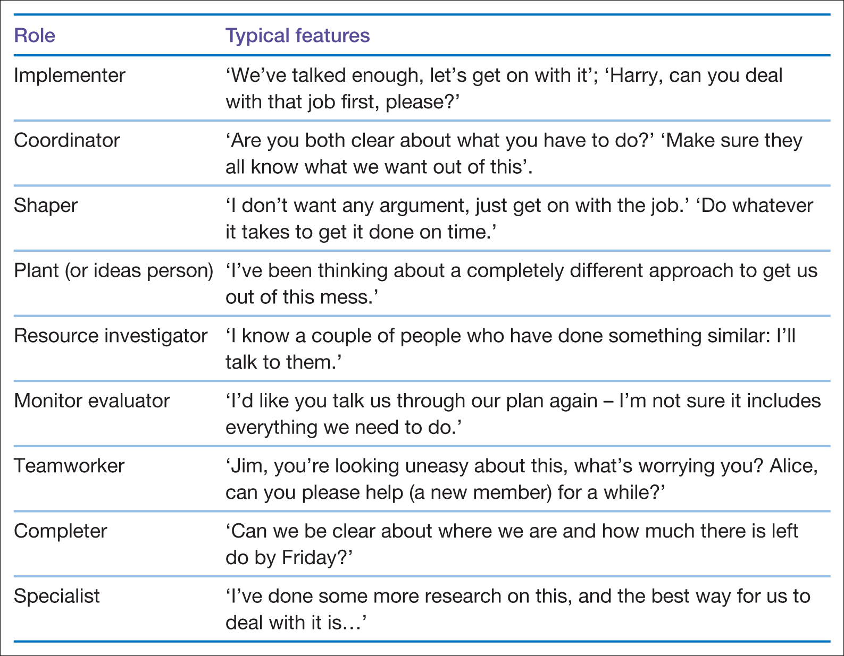
Team Dynamics

Slide 42
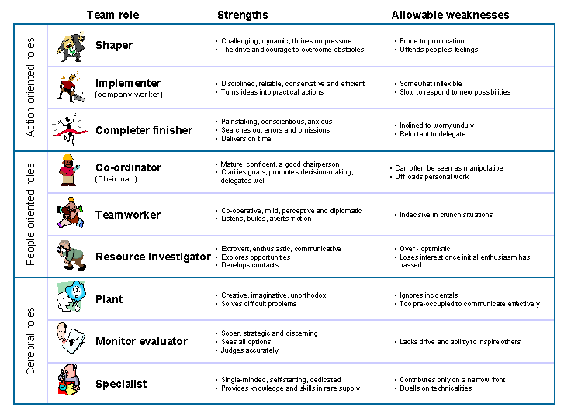

Slide 43
Belbin Questionnaire
Who was surprised by their result?
Were all of your highest scoring roles in the same group of roles?

Slide 44
Belbin
Belbin’s Team Roles Theory
-focus on co-located teams
-does not address Virtual Teams
-does not address culture

Slide 45
The Thinking roles
Plant, Monitor Evaluator, and the Specialist
-least impacted by the shift to virtual team
-different cultural perspectives can be an advantage
Notes:
In fact, the physical distance may be helpful to some of these roles: it can help the plant attain a better view of the situation without interference from the continuous interaction with the team members. The same is true for the Monitor/ Evaluator, whose job is to pass objective judgment on different ideas and solutions. As for the Specialist, a virtual team can help mitigate some of the acceptable weaknesses of that role, including the Specialist’s natural dislike for working in groups.

Slide 46
The Action Roles
Shaper, Implementer, Completer finisher
- awareness of culture required
- written communication across cultures can be misinterpreted
Notes:
GVT’s often rely on written communication.
Some of these roles need to make adjustment to correct for the geographic, and possibly cultural, dispersal of the team. Because virtual teams are best run in a command-and-control manner the Implementer (who turns basic ideas into plans) needs to create clear and concise implementation steps, and follow up closely to avoid any misunderstandings.
As for the Shaper, the virtual nature of the team can amplify his/her weaknesses: the risk of offending team members becomes much higher when using written communication media like e-mails and when working across cultures on global virtual teams. The same is true for the Completer/ Finisher, whose painstaking attention to details can be misinterpreted when communicated remotely and across cultures. Special training in cross-cultural communication and in written communication may be needed for the team members who play these roles remotely.

Slide 47
The Social Roles
Co-ordinator, Teamworker, Resource Investigator
- need to make the most adjustment
- cross-cultural skills essential
Notes:
In virtual teams, Coordinators need to adopt command-and-control methods rather than facilitation methods. Recent research by Insead Professor José Santos indicates centrally-supervised, hierarchical virtual teams perform much better than those that employ consensus building. Consequently, Coordinators needs to play the role of orchestra conductors in allocating the work among team members.
In addition, virtual teams benefit from clearly defined rules governing communications, meetings and deadline, rules that should be established and enforced by the Coordinator. Finally, because of global nature of many virtual teams, the coordinator must be adept at working across cultural boundaries .
Cross-cultural skills are also essential for Team Workers and Resource Investigators in virtual teams. A Team Worker needs to be able to bridge the cultural gap present in most global team, and a Resource Investigator should be able to project his/her social skills across cultures in order to be able to locate assets and resources on a global level.

Slide 48
Cultural background and team roles
Schneider and Barsoux (2003) – some cultures have a preference for certain roles.
Inglehart (1997) – European study
French- good at generating ideas
Germans- good at structuring tasks
Swedes- good at obtaining the needs to perform

Slide 49
The effects of culture
Hofstede (1991)- “collective programming of the mind”
Our culture affects our attitudes and behaviours
Anything that undermines the communication of intended meaning is referred to as noise. The more dissimilar the culture, the bigger likelihood of noise. (Deresky, 2017)
Notes:
Through your time at university and when you go out into the world of work you will be working with many people from many different cultures.
In teams made up of individuals from different cultural backgrounds it is common for miscommunications to arise. Even when 2 people are communicating in the same room in the same language then there can be interference in the communication known as noise. Culture is the noise that can cause the message to be distorted.
Anything that undermines the communication of intended meaning is referred to as noise. The more dissimilar the culture, the bigger likelihood of noise. (Deresky, 2017)
What is culture?
Geert Hofstede, a widely known Dutch researcher of culture, has defined culture as "the collective programming of the mind which distinguishes the members of one group or category of people from another." (1991, p.5).
The backpack that we carry around with ourselves, the social norms, values and behaviours that we have picked up from our parents, grandparents and teachers.
Understanding different cultural views and norms can give us a lens with which understand the behaviour of others and also understand how they view us. In terms of teamwork there are a few areas we should consider so that the team can work effectively together and not spend too long in the storming phase or find that they have stalled further down the line because of miscommunications.

Slide 50
The effects of culture
Meyer (2014) breaks this down into 8 key areas
Communicating
Evaluating
Persuading
Leading
Deciding
Trusting
Disagreeing
Scheduling
Meyer, E. (2014) The Culture Map. Public Affairs

Slide 51
Communicating
Low context/high context cultures
In a low context culture good communication is very explicit and direct and clear.
In a high context culture there is a reliance on shared meaning and symbols to interpret hidden meaning
Notes:
The scale for communicating runs from low to high context.
In a low context culture good communication is very explicit and direct and clear
In a high context culture there is a reliance on shared meaning and symbols to interpret hidden meaning
A low context culture? –US
Can anyone guess a high context culture? Japan, China
The UK is fairly low context.
Its not always about where you are on the scale- its about where you are compared to the culture you are comparing to. Its all relative.
Why is this important for teamwork?
If you are working with someone who is from a higher context culture there communication will not be as explicit as yours. What they say or write might not be what they really mean. You need to be ready to read between the lines or’ read the air’. An understanding of how something is said, or what is not said.
For example. Can you get X done by next week? A sharp sucking in of breath/ a non committal answer, it will be difficult. Does that mean no?
Get things written down in lower context cultures. But in higher context cultures this could be seen as a lack of trust

Slide 52
Evaluating- direct negative feedback
The scale for evaluating runs from those cultures who prefer direct negative feedback to those who would rather negative feedback was delivered in a less direct (indirect) manner
Notes:
The scale for evaluating runs from those cultures who prefer direct negative feedback to those who would rather negative feedback was delivered in a less direct (in direct) manner
Who has heard of the sandwich method for giving negative (sometimes called constructive!) feedback?
This is where more negative comments are sandwiched between 2 good points, thus softening the blow.
This is a common method used in the US which can be confusing when the US low context way of communicating is factored in.
This often means that those who are from a more direct negative feedback culture misinterpret the severity of what a US colleague is saying to them.
Direct- Russia, Germany, Netherlands
In the middle US UK
Indirect Japan, Thailand, Indonesia
Why is this important for group work? Some members of the group could be offended and upset by what those more direct cultures are saying. Equally those from more direct cultures could miss the severity of what they are being told by those that are more indirect.

Slide 53
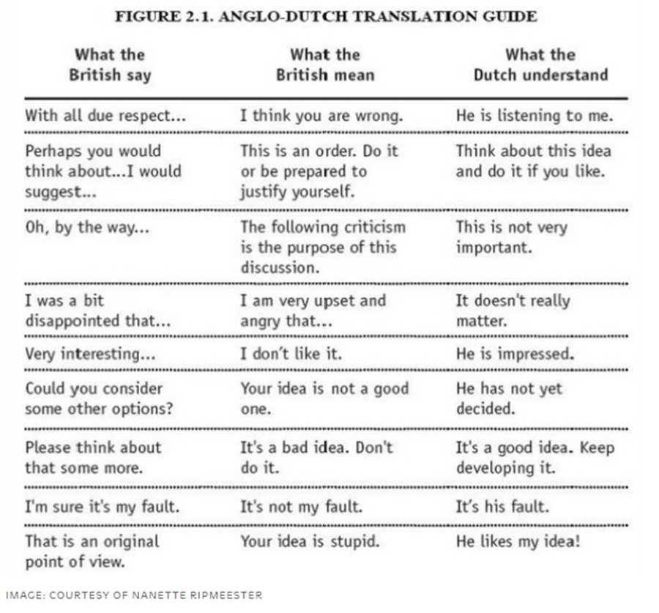
Delivering negative feedback

Slide 54
Persuading
The persuading scale runs from specific to holistic
Principles First v.s. Applications First
Principles first logic: deductive reasoning using theory/ concepts; the why before the how
Applications first logic: inductive reasoning using empirical data; problem solving by extrapolation; the how rather than the why
Notes:
In a specific culture, people usually respond well to receiving very detailed and segmented information about what is expected of each of them. If you need to give instructions to a team member from this kind of culture, focus on what that person needs to accomplish and when. Conversely, if you need to motivate, manage, or persuade someone from a holistic culture, spend time explaining the big picture and how all the pieces slot together.
How is this best addressed in a business setting?
Best strategy for persuading a multicutural audience is to cycle back and forth between theory and examples.
Application first: US, Canada, Australia, UK
Principles first: Italy, France, Russia, Spain
How does this effect teamwork? If trying to convince your group to move in a different direction then you might lose them along the way before you’ve finished your argument. For example applications first US UK get to the point quickly, then stick to it. Principles first spend time introducing the topic, building argument before giving conclusion, they will have lost the US/UK before getting to the conclusion.

Slide 55
Leading
The Leading scale runs from egalitarian to hierarchical
Are there many layers in the organisation?
Is it a flat organisations?
How easy is it to talk to your manager/next manager up?
Hofstede- Power/Distance
Notes:
Egalitarian-believing in or based on the principle that all people are equal and deserve equal rights and opportunities.
Is everyone in the group being treated as equals? Is there a hierarchy?
What other theories of cultural dimensions can we draw comparisons with?
Hofstede- Power distance
Schwartz’s Hierarchy vs. Egalitarianism
How does this affect group work?
Does the group have a clear leader? Are they expected to have all the answers? Does everyone have respect for them? Can they disagree with the leader/challenge them? How does the actions of the leader affect the rest of the team?

Slide 56
Deciding
The deciding scale runs from consensual to top down.
Is everyone involved in making decisions or does the boss make the decision and everyone accepts it.
Most cultures have a similar position on the Leading and Deciding scales.
Notes:
This can also be thought of as Group decision making v.s. Individual decision making
Is everyone involved in making decisions or does the boss make the decision and everyone accepts it.
Most cultures have a similar position on the Leading and Deciding scales.
Egalitarian cultures usually prefer consensual decision making, e.g. in Scandinavian societies.
BUT exceptions include Americans (egalitarian in leading, but top-down in decision making) and Germans (hierarchical in leading, but consensual in decision making).
Implications for projects further down the line…
Top-down decision making cultures, decisions usually made quickly, early in the process, by one person; BUT each decision is also flexible and the group may revisit or change it along the way very quickly as more discussion occur, new information arises or a different option surfaces. Decision making is dynamic and implementation may take a longer time.
Consensual decision-making cultures, decision making takes longer as more people are consulted to reach a consensus; however, once a decision has been made, the implementation is typically quite rapid as everyone has achieved buy-in. The moment of decision-making is taken quite seriously as the pivotal moment in the process.
What should you do to work effectively in a global team?
Discuss and agree on a decision making method upfront, e.g. via voting or consensus, whether 100% agreement is important, and how flexible is decision made? Can change decision after a decision has been made?

Slide 57
Trusting
The trusting scale runs from task based to relationship based.
Head v.s. the Heart;
Trust in ability v.s. Trust in emotional closeness
Notes:
The trusting scale runs from task based to relationship based
The Head v.s. the Heart; Trust in ability v.s. Trust in emotional closeness/ empathy and affection at a personal level
.
In relationship-based cultures, out-of-the-blue emails to a new contact may not be prioritised. It may be more effective to start with a phone call to build relationships.
Longer social-talk at the beginning of meetings with relationship-based cultures; Cut to the chase and start with the agenda promptly with task-based cultures.
BUT friendliness may not equate to relationship-forming. Eg Americans are friendly to all, but that may not mean anything deeper.
How does this affect group/teamwork? Should the group socialize together first to get to know each other so that trust and respect and a willingness to cooperate can be built, or is it ok to jump straight in?
Task based US Netherlands, Australia, Denmark
Relationship based: India, China, Nigeria, Saudi Arabia

Slide 58
Disagreeing
The disagreeing scale runs from confrontational to avoids confrontation
Is a disagreement seen as a spirited debate or personal attack?
Notes:
What could happen if you don’t understand the disagreeing scale?
People could be offended and leave the group- it could put the group back to the storming stage.
Strategies for disagreeing on a cross-cultural team: Play with language, consider using down-graders or softer language such as “I do not quite understand your point” or “Please explain more about why you think that” instead of “I don’t agree”.

Slide 59
Scheduling
The scheduling scale runs from linear time to flexible time
Germany very linear
Builds on the work of Edward T. Hall
In The Silent Language (1959), Hall coined the term "polychronic" to describe the ability to attend to multiple events simultaneously, as opposed to "monochronic" individuals and cultures who tend to handle events sequentially.
Notes:
The scheduling scale runs from linear time to flexible time
Generally, cultures with more predictable and orderly infrastructure (e.g. trains that run on time) tend to be linear-time cultures, while cultures with less reliable infrastructure tend to be flexible-time cultures
Linear time- Germany,Switzerland, Japan
Flexible time- India, Nigeria, Saudi Arabia, China
In linear time cultures projects steps are approached sequentially, completed one by one before the next. Promptness and good organisatins over flexibility
In Flexible time more fluid manner, changing tasks as opportunities change. Many things dealt with at once. Interruptions accepted. Adaptability and flexibility valued over organization.
How is this important in business?
Do meetings always start on time?
Do they follow the agenda?
Is it acceptable to be late? Even when meeting for the first time?
Easy to see how this can affect a Team. Are people sitting around waiting because other members are late? Are others taking phone calls in meetings and perceived as rude and wasting others time?
Also need to consider time zones for GVTs

Slide 60
Guidelines for culturally diverse teams
Team members must recognize and be prepared to deal with their differences
  Become aware of own and others stereotypes
Team leader must help team to identify and define overall goal
Members must have equal power
Mutual respect among team members
  Manager to chose members of equal ability and makes prior accomplishments and skills known to the team
Manager must give feedback to help team establish idea of what is good or bad
McFarlin, D. and Sweeney, P. (2013) International Organizational Behaviour

Slide 61
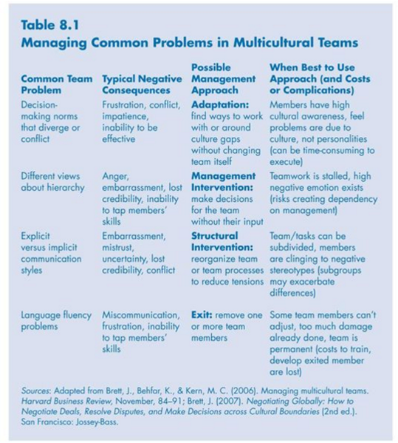
McFarlin, D. and Sweeney, P. (2013) International Organizational Behaviour

Slide 62
Practical implications
Limiting diversity can lead to missing out on valuable employees, may also cause organizations to pass up on the competitive advantage cultural diversity they may hold, etc.
Cultural diversity is argued to be more positively related to performance when a team has a shared superordinate identity or sees itself as separate individuals.
However, these may be difficult to apply, induce identity threat, negate the positive effects of cultural diversity, etc.
To address the problems create an environment where employees feel secure and mistakes are seen as learning opportunities and reason for punishment.
Could be achieved by appropriate training and compensation and feedback system.
Erin Meyer Harvard Business Review May 2014

Slide 63
LEADERSHIP IN MULTICULTURAL TEAMS
Multicultural – Team that has individuals from 3 or more ethnic backgrounds
Data collected from expatriate senior managers working in Thailand. The results show that the majority of expatriate executives make adjustments to their leadership approach (Tsai et al., 2019).
Most expatriate leaders used the exploration mode of adjustment, under which both they and subordinates made substantial behavioural adaptations (Rao‐Nicholson et al., 2020)

Slide 64
Tips for effective teamwork
Support
Encourage
Collaborate
Co-operate
Be positive
Offer constructive criticism
Receive criticism
Notes:
Support
Talk through any difficulties and concerns you have and encourage other members of the group to do the same. You can help each other to find solutions and develop your confidence together.
Encourage
Let others know what they do well and ask their opinions. If you appreciate a particular contribution, or you find a person’s comments helpful or relevant, tell them.
Collaborate
Divide different aspects of your study between you. -Use a Gantt chart
Co-operate
Develop each other’s ideas by continuing them to a logical. If a member of your group is struggling with a difficult task, help them by offering your time and advice when possible.
Be positive
If you disagree with another person’s ideas, and if the issue needs to be addressed, phrase your suggestions in a positive way. Suggest ways of moving forward and making improvements rather than focusing on what is, or was, wrong.
Offer constructive criticism
Comment on behaviour and outcomes, not on people. Point out what is good as well as what can be improved.
Receive criticism
If a suggestion or a point you have made is criticised:
Listen attentively to the person’s point of view
Take time to think about what has been said
Ask questions to clarify any areas of confusion

Slide 65
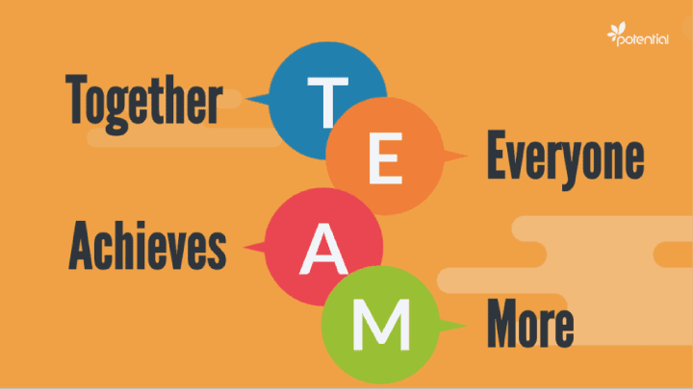

Slide 66

What theories can we use to organise our discussion on teamwork?
Thinking about your assignment…

Slide 67
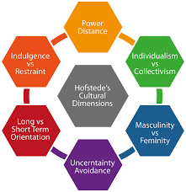
Hofstede’s cultural dimensions
Notes:
Masculinity vs Feminity has had a name change Motivation towards Achievement and Success

Slide 68
INDIVIDUALISM (IDV) vs collectivism
The high side of this dimension, called Individualism, can be defined as a preference for a loosely-knit social framework in which individuals are expected to take care of only themselves and their immediate families.
Individualist: US, Canada, UK
Collectivist: Hong Kong, Singapore and Mexico
Nigeria highly collectivist.
Notes:
Individualistic societies have loose ties that often only relate an individual to his/her immediate family. They emphasize the "I" versus the "we". Its counterpart, collectivism, describes a society in which tightly integrated relationships tie extended families and others into in-groups. These in-groups are laced with undoubted loyalty and support each other when a conflict arises with another in-group
Indian society is collectivistic and promotes social cohesion and interdependence. The traditional Indian joint family, which follows the same principles of collectivism, has proved itself to be an excellent resource for the care
Nigeria- Close long-term commitment to the member ‘group’, be that a family, extended family, or extended relationships. Loyalty in a collectivist culture is paramount and overrides most other societal rules and regulations. The society fosters strong relationships where everyone takes responsibility for fellow members of their group.
How easy is it to get a job in a highly collectivist culture?
In groups take care of each other in return for loyalty.

Slide 69
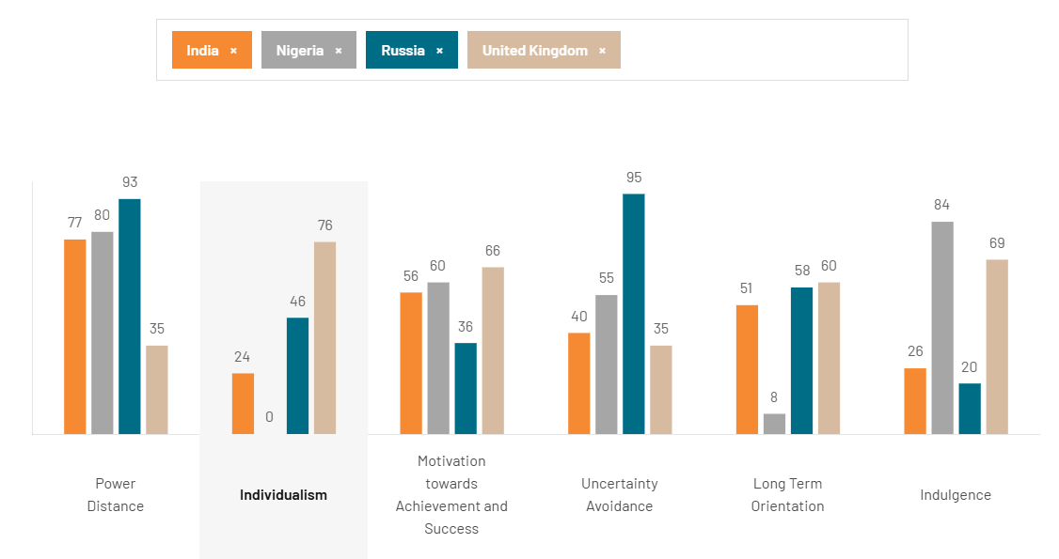
Notes:
India
24
India, with a rather low score of 24, is a society with both collectivistic and Individualist traits. The collectivist side means that there is a high preference for belonging to a larger social framework in which individuals are expected to act for the greater good of one’s defined in-group(s). In such situations, the actions of the individual are influenced by various concepts such as the opinion of one’s family, extended family, neighbors, work group, and other such wider social networks that one has some affiliation toward. For a collectivist, to be rejected by one’s peers or to be thought lowly of by one’s extended and immediate in-groups, leaves him or her rudderless and with a sense of intense emptiness. The employer/employee relationship is one of the expectations based on expectations – Loyalty by the employee and almost familial protection by the Employer. Hiring and promotion decisions are often made based on relationships which are the key to everything in a Collectivist society.
The Individualist aspect of Indian society is seen as a result of its dominant religion/philosophy – Hinduism. The Hindus believe in a cycle of death and rebirth, with the manner of each rebirth being dependent upon how the individual lived the preceding life. People are, therefore, individually responsible for the way they lead their lives and the impact it will have upon their rebirth. This focus on individualism interacts with the otherwise collectivist tendencies of Indian society which leads to its intermediate score on this dimension.
Overview
Nigeria
0
Nigeria, with a score of 0, the lowest score in the database, is a highly collectivistic society. This is manifest in a close long-term commitment to the member ‘group’, be that a family, extended family, or extended relationships. Loyalty in a collectivist culture is paramount and overrides most other societal rules and regulations. The society fosters strong relationships where everyone takes responsibility for fellow members of their group. In collectivist societies, offense leads to shame and loss of face, employer/employee relationships are perceived in moral terms (like a family link), hiring and promotion decisions take account of the employee’s in-group, and management is the management of groups.
Overview
Russia
46
If Russians plan to go out with their friends they would say “We with friends” instead of “I and my friends”, if they talk about brothers and sisters it may well be cousins, so a score of 46 even finds its manifestations in the language. Family, friends, and not seldom the neighborhood are extremely important to get along with everyday life’s challenges. Relationships are crucial in obtaining information, getting introduced, or successful negotiations. They need to be personal, authentic, and trustful before they can focus on tasks and build on a careful to-recipient, rather implicit communication style.
Overview
United kingdom
76
At a score of 76 the UK is an Individualist society. The British are highly Individualist and private people. Children are taught from an early age to think for themselves and to find out what their unique purpose in life is and how they uniquely can contribute to society. The route to happiness is through personal fulfillment. As the affluence of Britain has increased throughout the last decade, with wealth also ‘spreading North’, a much-discussed phenomenon is a rise of what has been seen as rampant consumerism and a strengthening of the ‘ME’ culture.

Slide 70
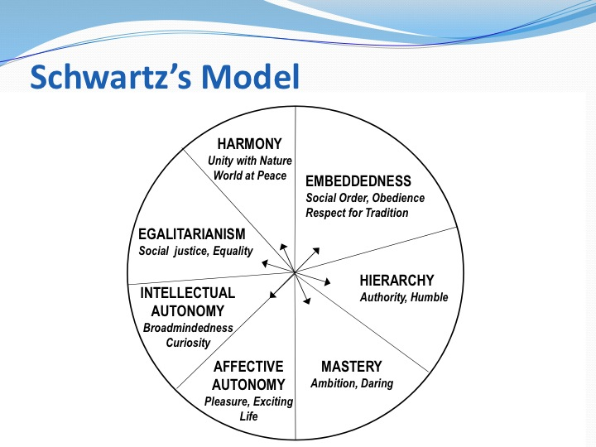

Slide 71
Notes:
Conservatism (also called embeddedness) represents a culture’s emphasis on maintaining the status quo, propriety, and restraining actions or desires that may disrupt the solidarity of the group or the traditional order
Intellectual and affective autonomy refer to the extent to which people are free to independently pursue their own ideas and intellectual directions, and their affective desires, respectively
Embeddedness
This is a focus on sustaining the social order, of avoiding change and retaining tradition. Group norms are important.
What does this remind you of? Hofstede Individualism/collectivism, LTO and Uncertainty Avoidance
Autonomy
Where individuals have control over their choices as opposed to having to consider others and shared rules.
Affective Autonomy is the independent pursuit of pleasure, seeking enjoyment by any means without censure. In many societies there are limits when affective autonomy leads to taking banned substances or acting in ways that distresses or harms others.
Intellectual Autonomy is the independent pursuit of ideas and thought, whether it is theoretical, political or whatever. In embeddedness cultures it is hard to police what people are thinking, though actions can be taken to monitor intellectual publishing and discussions.
What does this remind you of from Hofstede? Individualism

Slide 72
Interactions- people and the group
Group is central
Hofstede- Collectivism
Interdependent, motivated by norms and duty, prioritise in group goals, connected relationships
Schwartz- Embeddedness
Search for meaning in social relationships, identification, shared way of life and shared goals
Individual is central
Hofstede- Individualism
Autonomous, independent, motivated by own needs and goals, rational relationships
Schwartz- Autonomy
Express own preferences, feelings, ideas and abilities
Notes:
Nigeria 0 Nigeria, with a score of 0, the lowest score in the database, is a highly collectivistic society. This is manifest in a close long-term commitment to the member ‘group’, be that a family, extended family, or extended relationships. employer/employee relationships are perceived in moral terms (like a family link), hiring and promotion decisions take account of the employee’s in-group,
Japan 62 Individualistic. Japanese society does not have an extended family system like China and Korea. Japan has been a paternalistic society and the family name and asset was inherited from the father to the eldest son. The younger siblings had to leave home and make their living with their core families. Japanese are famous for their loyalty to their companies, which people have chosen for themselves, which is an Individualist thing to do. You could say that the Japanese in-group is situational. Japanese are more private and reserved than most other Asians.
India 24 is a society with both collectivistic and Individualist traits. he employer/employee relationship is one of the expectations based on expectations – Loyalty by the employee and almost familial protection by the Employer. Hiring and promotion decisions are often made based on relationships which are the key to everything in a Collectivist society.The collectivist side means that there is a high preference for belonging to a larger social framework in which individuals are expected to act for the greater good of one’s defined in-group(s)dominant religion/philosophy – Hinduism. The Hindus believe in a cycle of death and rebirth, with the manner of each rebirth being dependent upon how the individual lived the preceding life. People are, therefore, individually responsible for the way they lead their lives and the impact it will have upon their rebirth.
https://www.hofstede-insights.com/country-comparison-tool?countries=greece%2Cindia%2Cjapan%2Cnigeria

Slide 73
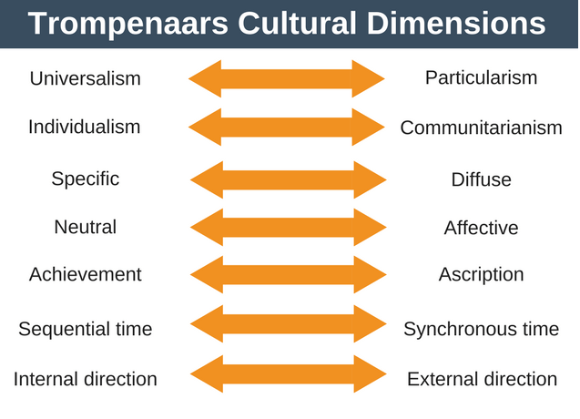

Slide 74
Individualism vs Communitarianism
Working as a team or an individual?
Individualistic cultures- outcomes are the result of your choices
Eg Canada, US, UK, Switerland
Communitarianism- quality of life is better if we help each other
Eg Japan, China, latin America, much of Africa
Notes:
Do people want to achieve recognition for their individual achievement?
Clearly building on Hofstede
Individualistic- decision makers can make decisions without consulting others, therefore happens more quickly. Look after own happiness
Working in these cultures you should reward on an individual basis, encourage use of initiative, try and align the individuals needs with those of the organisation
Communitarianism- Organised around groups- loyalty is important. Decision making takes longer as everyone inputs. Job turnover is lower due to high group loyalty
Reward group in public and praise group in public. Praise individuals in private. Whole team should be included in decision making.
Trompenaars research yielded some interesting results and suggested that cultures may change more quickly than many people realize. It may not be surprising to see a country like the United States with high individualism, but Mexico and the former communist countries of Czechoslovakia and the Soviet Union were also found to be individualistic in Trompenaars research. In Mexico, the shift from a previously communitarian culture could be explained with its membership in NAFTA and involvement in the global economy. This contrasts with Hofstede's earlier research, which found these countries to be collectivist, and shows the dynamic and complex nature of culture. Countries with high communitarianism include Germany, China, France, Japan, and Singapore

Slide 75
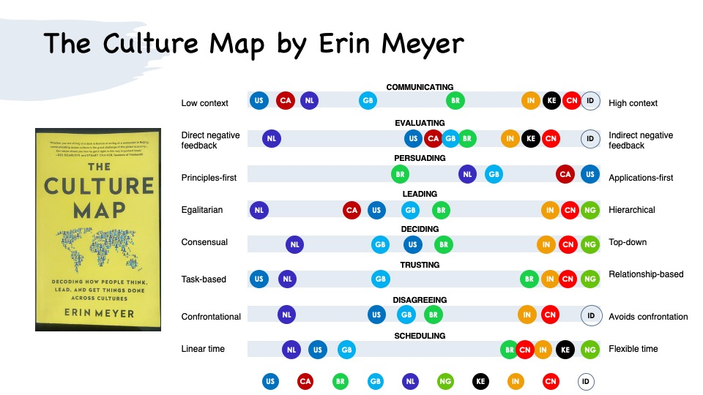

Slide 76
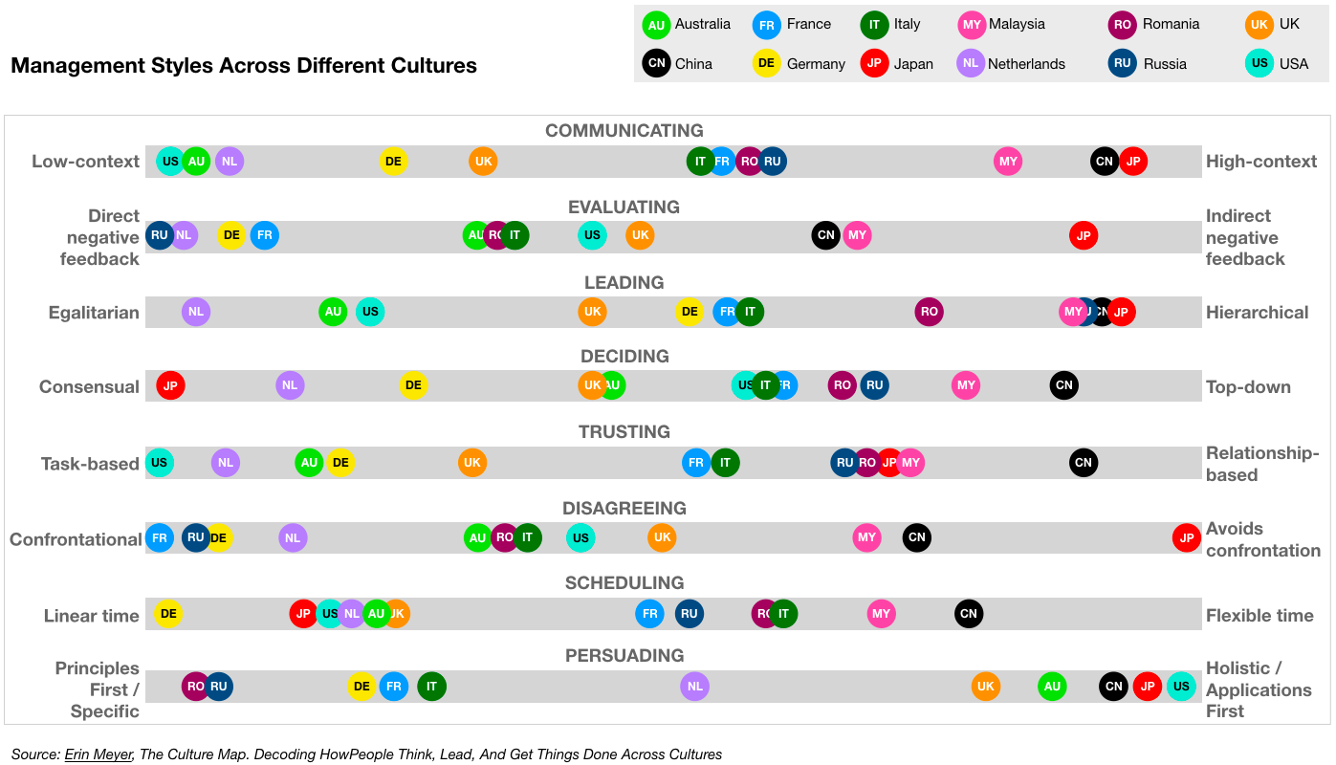

Slide 77
Summary
In today’s session we have looked at what a team is and the different stages it will go through whilst on its journey towards successful outcomes.
The effectiveness of a team is influenced not by intellect but by the team dynamics- the balance of the 9 Belbin roles.
The culture of each individual involved not only influences their role but the dynamic process within the team.
Culture will play a part in the effectiveness of a team as culture affects an individual’s behaviour and their understanding of shared social norms, values, and attitudes.

Slide 78
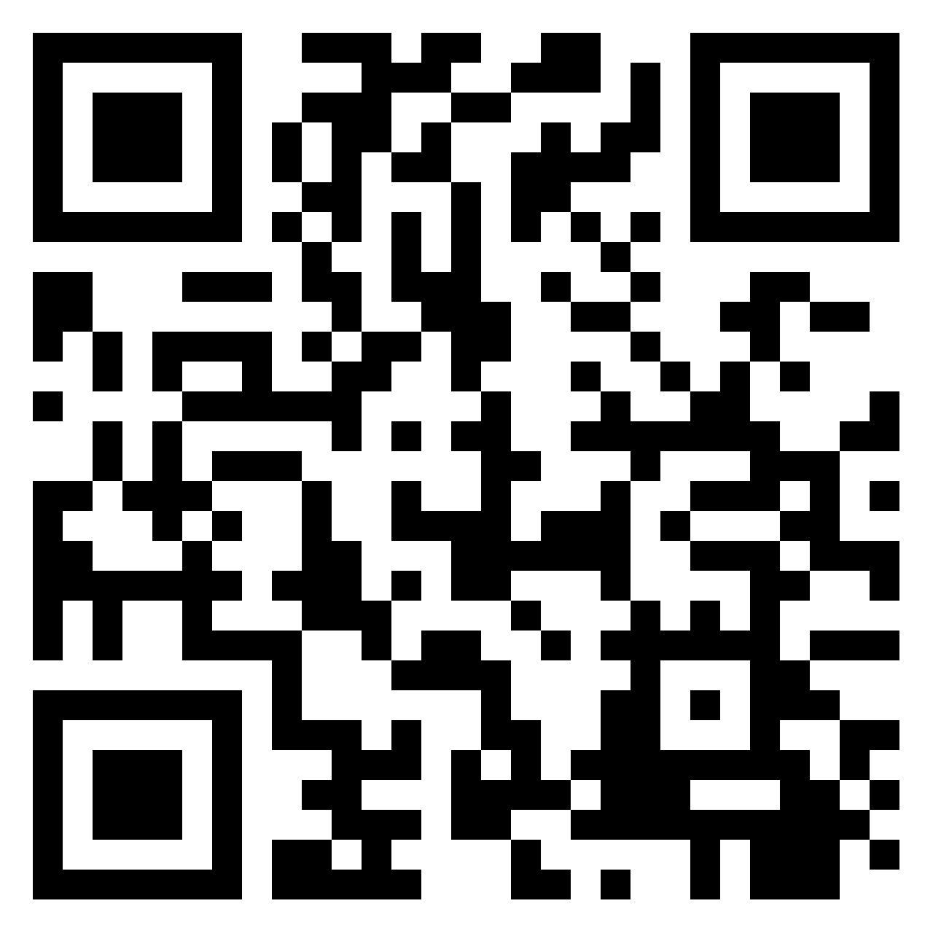
Assessment Queries Padlet https://uniofglos.padlet.org/shooke/bm7703-assessment-questions-u9xnmg0iqcmmqrh5

